Slide 1
Senior College Poster Project
Vanessa Leyva
Mrs. Ogden
AVID 12
Period: 1

Slide 2
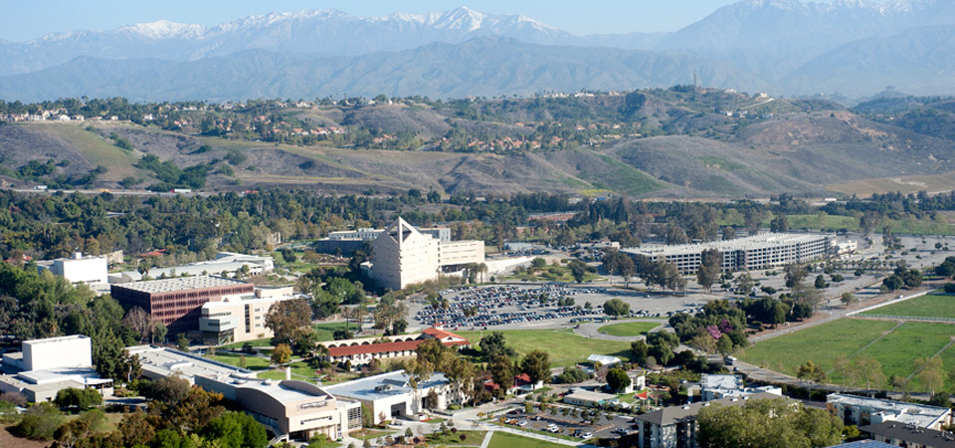
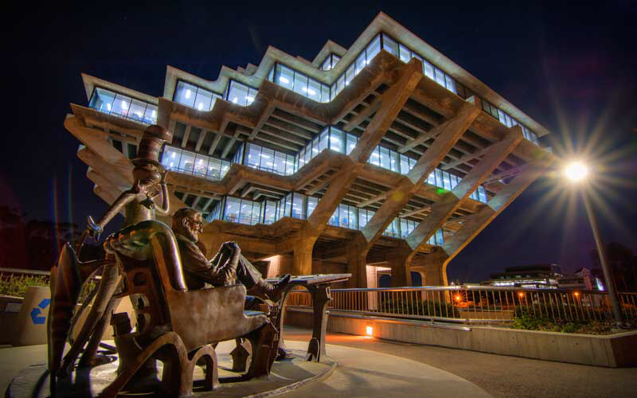
College Preferences
A small student—teacher ratio
A 4-university that is not religiously affiliated
A Cal State that is close enough to commute
An EOP program available so aid is available to students
A friendly environment in which many people are involved in clubs and sports
Availability of internships
Class availability
Attractiveness of college (appearance)

Slide 3
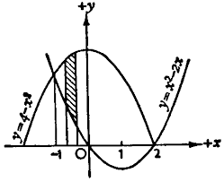
Majors
Mathematics
This may include applied mathematics, algebra, or calculus
Engineering
This may include computer engineering, electrical engineering, or mechanical engineering

Slide 4
CAREERS
A Pre-Calculus teacher
An Algebra teacher
An electrician/ electrical engineer
Work for a major technological incorporation such as Microsoft or Apple

Slide 5
TOP 10 List
Dream College: Cal Poly Pomona (GPA: 3.5 and SAT: 1065)
Reach Colleges: UCLA ( GPA: 4.3 and SAT: 1370), UCSD (GPA: 4.0 unweighted and SAT: 1350), or USC (GPA: top 10% and SAT: 1920-2250 on a 2400 scale)
Good Fit Colleges: Cal State Fullerton (GPA: 3.48 and SAT: 1110), Cal State Long Beach( GPA: 3.75 and SAT: 1060), UCR( GPA: 3.6 and SAT: 1180), SDSU (GPA: 3.69 and SAT:1190), Cal State Los Angeles
Safe Colleges: Cal State San Marcos, Chico Sate, Cal State East Bay

