Slide 1
Senior college project
Cynthia Cabrera
Period. 3

Slide 2
What characteristics are you looking for in a college?
Offers my major
Public/ Co-Ed
Student population to be from 5,000- 10,000
Financial aid
Well known for my area of study!

Slide 3
What major and career are you interested in?
Major: Early Childhood Education
Career: Elementary School Teacher
Steps to become an Elementary Teacher
Earn a Bachelor’s degree in Elementary Education
Pass a Licensing Exam
Earn a Master’s Degree
Participate in an ongoing Professional Development and Advance in your Career Simultaneously

Slide 4
DREAM COLLEGE & 2 reach colleges
UC Merced (3.5)
Small community
Currently 7,336 students
Tuition: $35,527
UC Riverside (3.6)
Graduate school of education
Tuition: $34,581
Campus size: 1,200 acres
San Diego State University (3.6)
3rd oldest university
Great study abroad programs
33,778 students

Slide 5
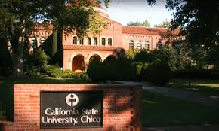
5 good fit colleges & 1 safe college
CSU Fullerton (3.48)
Tuition: $26,830
More than 37,000 students
Offers 107 degree programs
CSU Chico State (3.2)
17,287 students
Tuition: $24,120
Mascot is Willie the Wildcat
CSU San Francisco State (2.7)
Founded in 1899
Ranked 24th top college
Acceptance rate: 68%

Slide 6
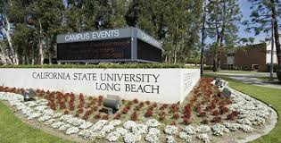
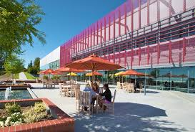
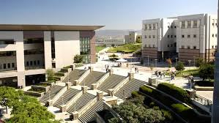
5 good fit colleges & 1 safe college
CSU Long Beach
Acceptance rate 34%
Act scores: 20-25
Third largest campus
CSU East Bay
Total enrollment: 14,823
Acceptance rate: 70.3%
342 acres
CSU San Marcos
15,537 students
390 international & exchange students
Mascot is Crash the Cougar

