Slide 1
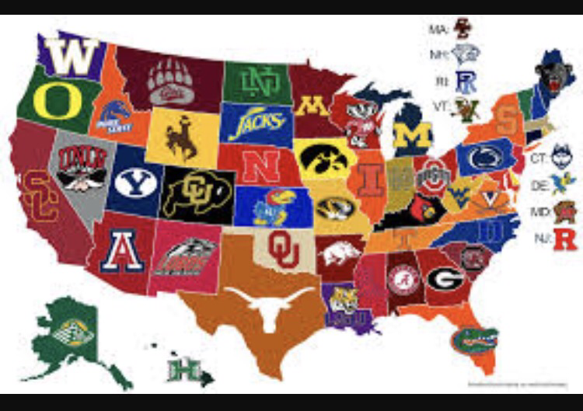
College interest project
Brenda Pineda
Per.3
9/15/17

Slide 2
College survey results
•Based on my survey my number one top match was UC Irvine
• from the colleges that I was matched with I am interested in cal state Long Beach and San Diego state university
https://www.forbes.com/forbes/welcome/?toURL=https://www.forbes.com/&refURL=&referrer=

Slide 3
Personalized College Profile
The majors I am interested in include: liberal arts , business and nursing
I prefer a College that has sports teams such as : Football and Basketball
The division of the sports team does not really matter to me but I want them to a win some games so division 2 would be preferred
I would like the College that I attend to be within 50 miles from my house so I can commute
I would like the location around the College to be in he suburbs

Slide 4
Personalized College profile continuation
I would like the College that I attend to be very diverse
The size of the College I would like is a more populated campus
I would also like a co- ed setting
Religious affiliation is not important but if it was I would like a Catholic environment
Greek life is not important to me
EOP program is not so important to me
Work study program is important to me
Study Abroad program is very important because I plan to travel during college

Slide 5
Housing is not important because I want to commute
Competitive GPA is not important because I don’t want tot go such a popular school that it is hard to get in
Financial aid is extremely important to me

Slide 6
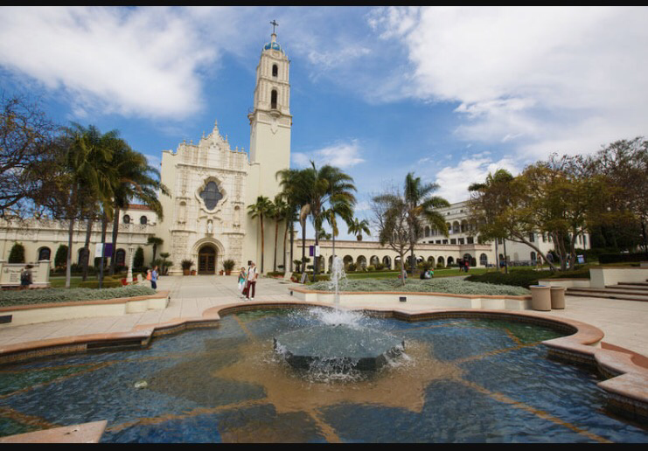
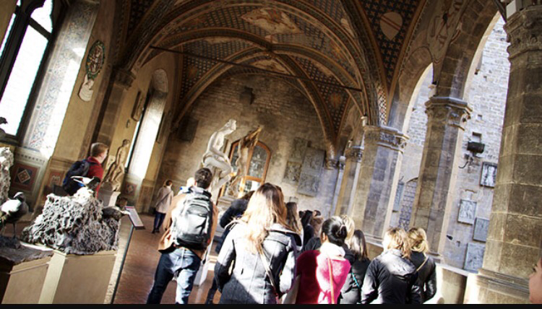
DREAM SCHOOL :university of san diego
•GPA :3.84
SAT:1290

Slide 7
Colleges that fit
#2 Cal state Dominguez hills
#3 Cal state LA
#4 Cal state Fullerton
#5 Cal state San Bernardino
#6 UC Merced

Slide 8
Reach colleges
#7 UC Santa Barbara
#8 UC Riverside
#9 Cal State Long Beach

Slide 9
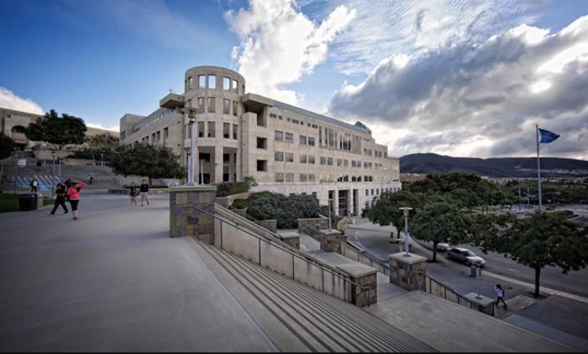
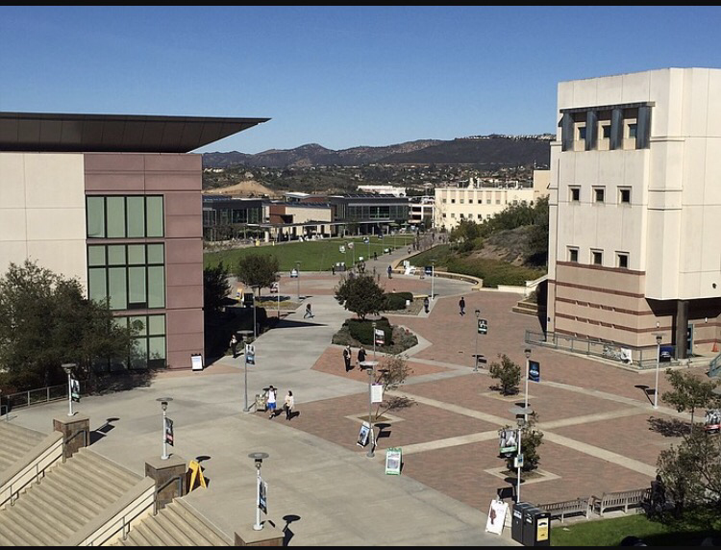
Safe College
#10 Cal State San Marcos

