Slide 1
Personalized College Profile
Daniel Lomboy

Slide 2
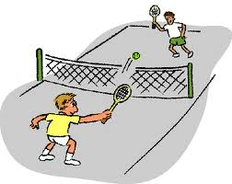
Characteristics in a College
4 year university
Public
Medium – Large (2,000 - >15,000)
Tennis courts
Urban/suburban lifestyle
Creative arts

Slide 3
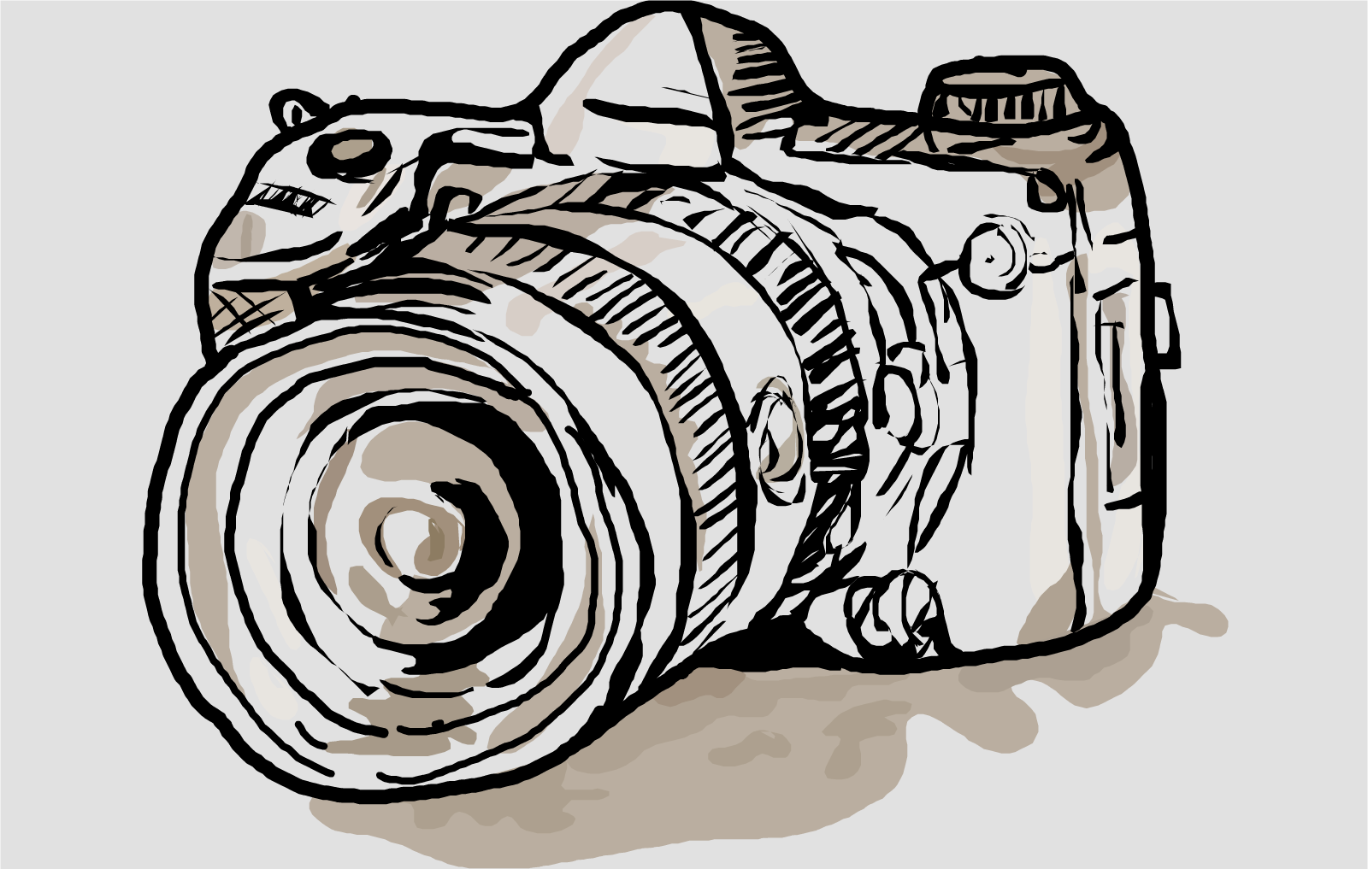
Majors
Nursing RN to BSN
Public Health
Physical Training/Kinesiology
Film

Slide 4
Careers
Nurse Practitioner (MS in Nursing)
Requirements: RN license, NP credentialing exam
Per diem Nursing
Requirements: RN license, NP credentialing exam
Film Directing
Requirements: No degree required, journalism, film, communication, arts management,
portfolio
Photography Studio
Requirements: No degree required, photography license, portfolio

Slide 5
Top 10 List
California State University: Fullerton
GPA: 3.53
SAT: 1110
ACT Composite: 22
California State University: Long Beach
GPA: 3.54
SAT: 1060
ACT Composite: 20-25
San Digeo State University
GPA: 3.69
SAT: 1190
ACT Composite: 22-27
San Jose State University
GPA: 3.40
SAT: 1120
ACT Composite: 19-25
San Francisco State University
GPA: 3.23
SAT: 1050
ACT Composite: 18-24

Slide 6
Top 10 List
Safe Colleges
California State University: San Marcos
GPA: 3.27
SAT: 1030
ACT Composite: 17-22
California State University: Los Angeles
GPA: 3.21
SAT: 980
ACT Composite: 15-20
California State University: San Bernardino
GPA: 3.21
SAT: 980
ACT Composite: 18

Slide 7
Top 10 List
Reach Colleges
University of California: Irvine
GPA: 3.94
SAT: 1250
ACT Composite: 27
University of California: Los Angeles
GPA: 4.31
SAT: 1370
ACT Composite: 27-33

