Slide 1
Senior College Project
Christa Unger
Period 3

Slide 2
Career Survey Results
Possible career choices include:
-Nursing
-Environmental policy
-advanced practice psychiatric nurses
-anthropologists
-majors that are an intellectual extreme sport and appeal to the analytical side of myself.

Slide 3
Personalized College Profile
In my college search I’m looking for a university:
-close to home (in the same state or a bordering state) but still far enough away that it allows me to learn to be independent.
-not in a rural area; either in a suburban or urban setting.
-diverse and not any smaller than under 5,000 students
-known for the area of study I am interested in
-in a climate with four seasons
-with a work-study program and a study abroad program
-that has the option of living in a dorm with a comfortable setup
-that has competitive GPA and test scores and high percentage of students who received financial aid.
The majors I am interested in, are biology and a physician’s assistant major.
The career I am interested in is being an emergency room physician’s assistant.

Slide 4
Colleges that fit Dream College
University if California San Diego

Slide 5
University of California San Diego
This is my dream college because it is close to my home while also being far enough to learn independency.
It also is one of the top schools to get an education to become a physician’s assistant.
The university also has competitive test scores and GPA which would mean that it is a college that would challenge me.
It is also located in a city that I am familiar with and enjoy being in.

Slide 6
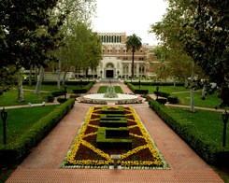
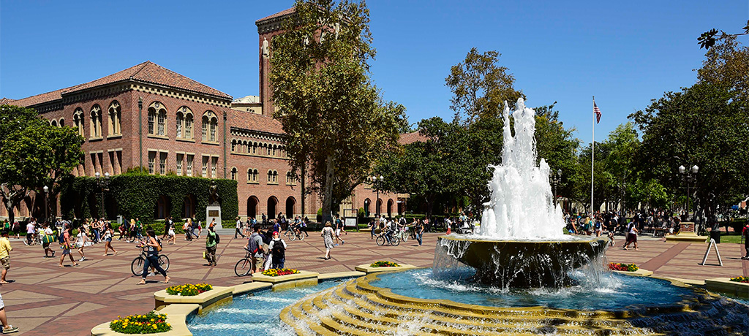
Reach College
University of Southern California

Slide 7
University of Southern California
This is a reach college for me because while the GPA is a good fit, the test scores are higher than mine.
I want to apply to this university because it has a variety of options for majors, in case I decide to do something different.
Also it is known as a great college so I know I would be getting a good education.
It is also located fairly close to my home.

Slide 8
Reach College
University of California Los Angeles

Slide 9
University of California Los Angeles
I want to apply to this college because it is another college that is well known and well respected.
It is considered a reach college because the test scores are higher than mine.
Also the appearance of this university appeals to me.

Slide 10
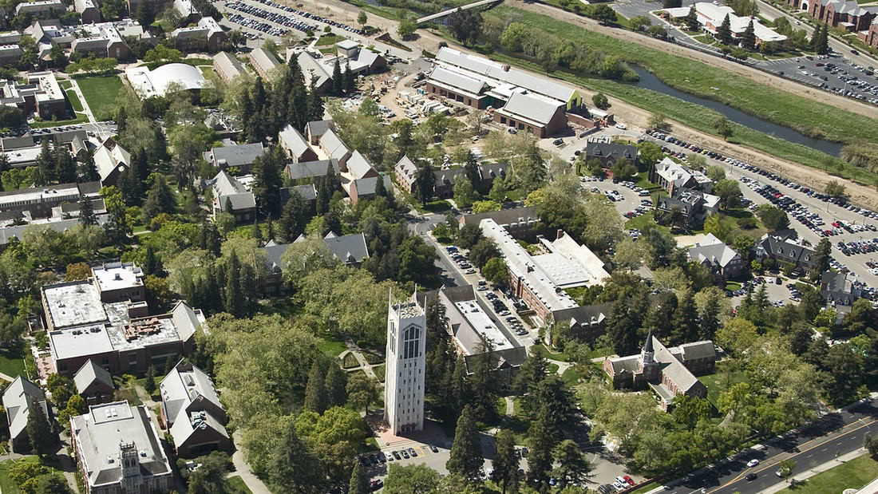
Good Fit College
University of the Pacific

Slide 11
University of the Pacific
The design of the buildings and atmosphere of the college attracts me.
Although it is far in distance, I would still be able to visit my family occasionally.
It also has the major I am interested in.
The GPA and test scores are a good fit with mine.

Slide 12
Good Fit College
University of San Diego

Slide 13
University of San Diego
This is considered a good fit college because the test scores and GPA are similar to what I have.
The location of the school is ideal for what I want to accomplish
They offer the major I want.
It’s a beautiful campus that I could be happy in and is located in a city that I am familiar with.

Slide 14
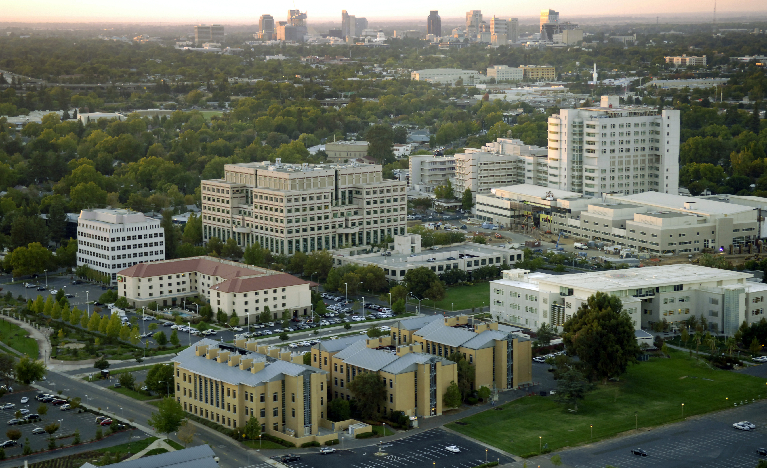
Good Fit College
University of California Davis

Slide 15
UC Davis
This can be considered a good fit because my GPA is within the range of this universities average while my test scores are only slightly too low.
The location is a good fit because it is still within the same state.
It also has a good variety of majors

Slide 16
Good Fit College
University of San Francisco

Slide 17
University of San Francisco
This is a good fit because the look of this college gives me a good vibe and has scenery I would enjoy looking at everyday.
It is located in a city I had only been to few times but enjoyed being in.
It is also located in the same state which is one of my preferences.

Slide 18
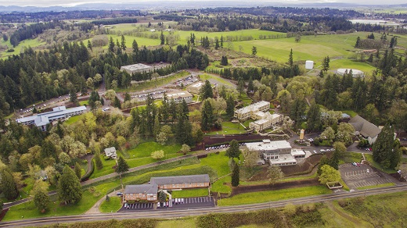
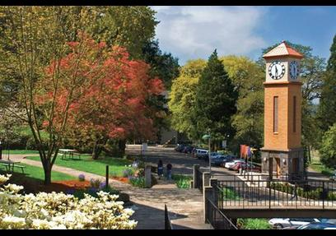
Good Fit College
Corban University

Slide 19
Corban University
It is a good fit because the surroundings of the college are beautiful and something that I feel would make me content if I had to live there.
I also got a letter from this college so there is a greater chance of me getting in.
The majors available there are satisfactory
Though it is in a different state, it is in a bordering state so that I am not too far from home.

Slide 20
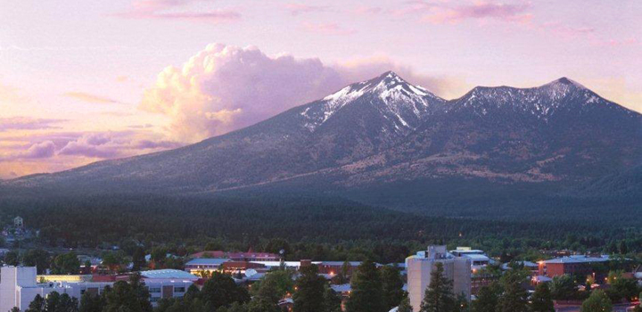
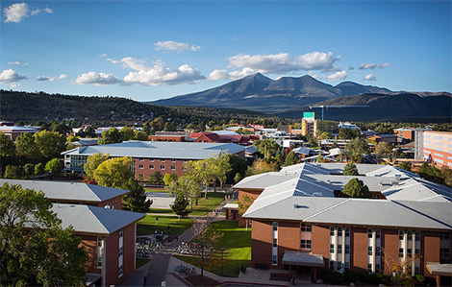
Safe College
Northern Arizona University

Slide 21
Northern Arizona University
This is considered a safe college because my GPA and test scores are well within the range of their average.
Also have guaranteed admission for those who have a 3.0 and above

Slide 22
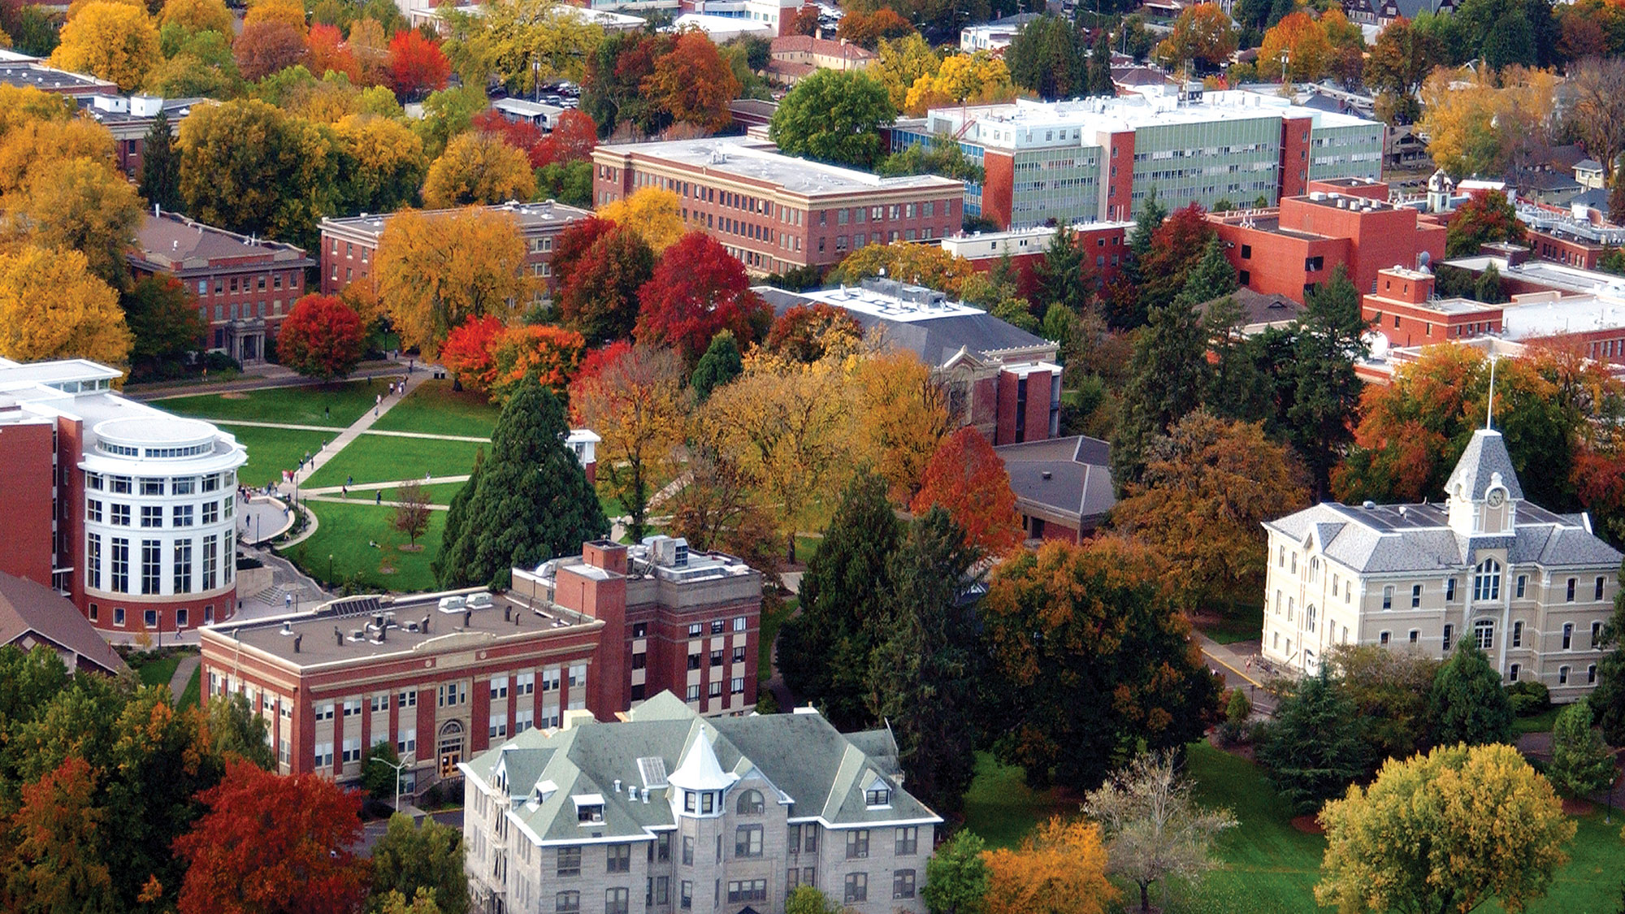
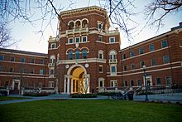
Safe College
Oregon State University

Slide 23
Oregon State University
This is a safe college because the test scores and GPA are not very competitive.
Also State Universities tend to be somewhat easier to get into.

