Slide 1
College Research Project!!
Rocio Vergara
Period 3
AVID 12

Slide 2
COLLEGE PREFERENCES
Diverse community
Things to do around the college
Clubs to join on campus
I would prefer a semester system for I think quarter systems move too quickly for me
I would prefer if the school had no religious affiliation

Slide 3
COLLEGE PREFERENCES CONT
The student population I would prefer to be large
The weather is not great importance to me HOWEVER I HATE THE EXTREME HEAT THAT’S A NO
I would like for it to have a study abroad program however that is not required
I would like if there is near by apartments to rent
I would like to know that most students receive financial aid

Slide 4
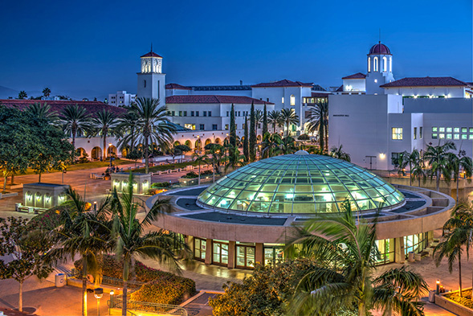
I would like to admire the environment of my college

Slide 5
MAJORS I LIKE

Slide 6
TOP TEN YO!!
1) SDSU ( reach)
2) Cal State Long Beach
3) Cal State Fullerton
4)San Francisco State
5) San Jose State

Slide 7
TOP TEN CONT
6) Cal State Channel Islands
7) Humbodlt State Univeristy
8) University of California – Merced
9) Cal State San Marcos
10) Northridge

Slide 8
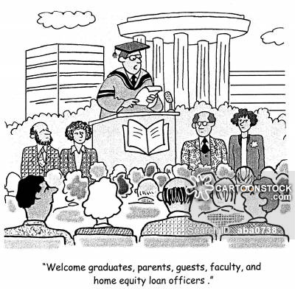
Man I’m just trying to be accepted

