Slide 1
My future
Andrew Cuevas presents

Slide 2
My College Preferences
The majors I want to see in my future college include engineering, business administration, economics, and finance.
If I where to be involved in spots I would like to have football and rugby at a D1, D2, and at a D3 school.
I don’t really care how far it is away from home.
I don’t really care if its in a rural, suburban, or urban setting. I want it to be a Co-Ed school and it doesn’t matter if its private or public.
The student population has to be diverse and under 5,000 or between 10,000 students.

Slide 3
My College Preferences continued
It is important that the area of the study is well known.
It is not important if it has the semester/trimester system.
The weather is important because I want to feel and see all the seasons.
Religious affiliation is not really important because I can always go to a church.
The Greek life is not that important to me but would l like it.
The EOP is not that important but if there is one I would be involved.
The work study program is not that important but just like EOP I would like to join.
The study abroad program is not that important.
I wouldn’t mind living in dorms or apartments what ever is easier for me.
I do want it to be competitive because I want to push myself.
I do want the percent of financial aid to be quite high because I can use the help.

Slide 4
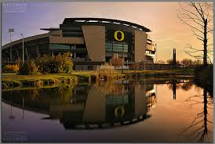
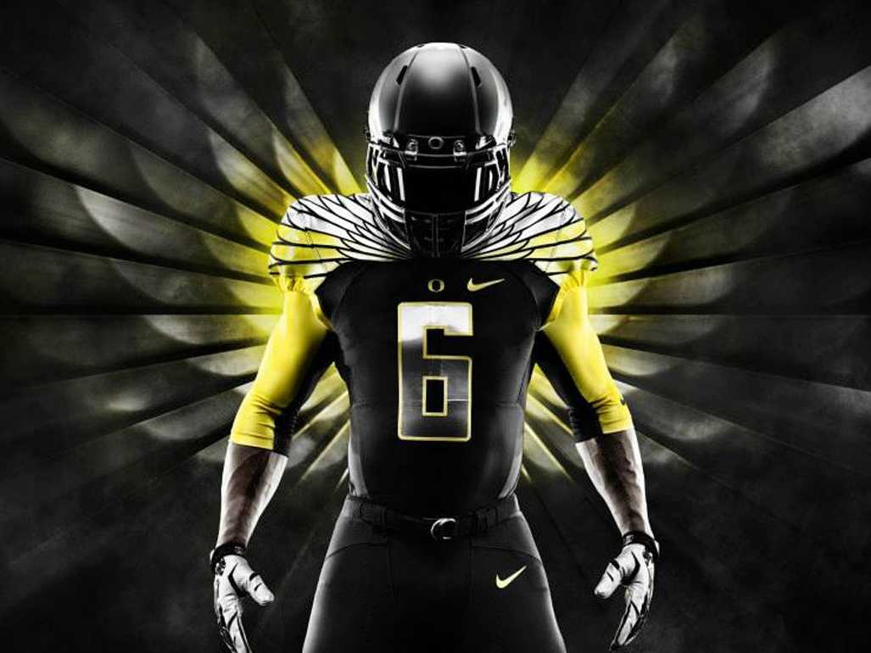
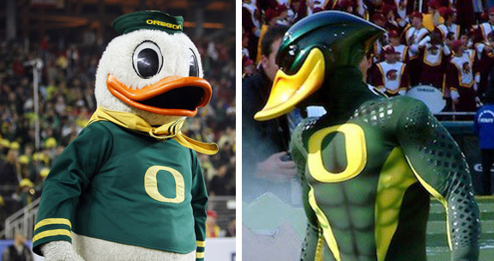
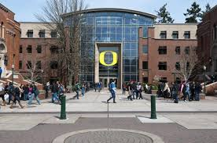
My Dream College
University of Oregon

Slide 5
Other Colleges and Reach Colleges
REACH COLLEGES
I have 5 reach colleges and they are
USC
UCSD
UCLA
TEXAS A&M
AND STANFORD
OTHER INTERESTING COLLEGES
OHIO STATE
BOSTON UNIVERSITY
DUKE
VIRGINIA TECH
AND ASU

Slide 6
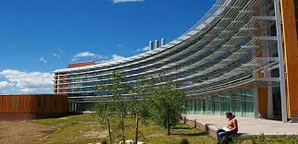
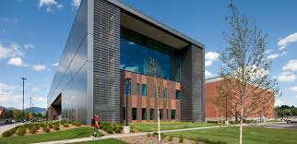
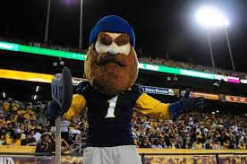
My Safe School
NAU

